Slide 1
Project Q-Zoom
Realized by the team BestPRo
Team members:
Claude Aloumon
Jong Kook Son
Muhammad Usman

Slide 2
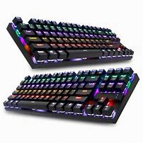
Introduction
This project Q-zoom has been designed in the framework of the hackaroo contest.
Q-zoom has two specific aspect a quiz aspect and a game side.
Both had been made to help the Zoom class very interesting and amazing for all the students.

Slide 3
Q-zoom is built using spark AR. This software is a creation tools built for novice javascript developers and 2D artists, to sophisticated 3D modelers and visual effects designers.
The next section will have two sections:
1-Description of the quiz tool
2- Description of the game tool

Slide 4
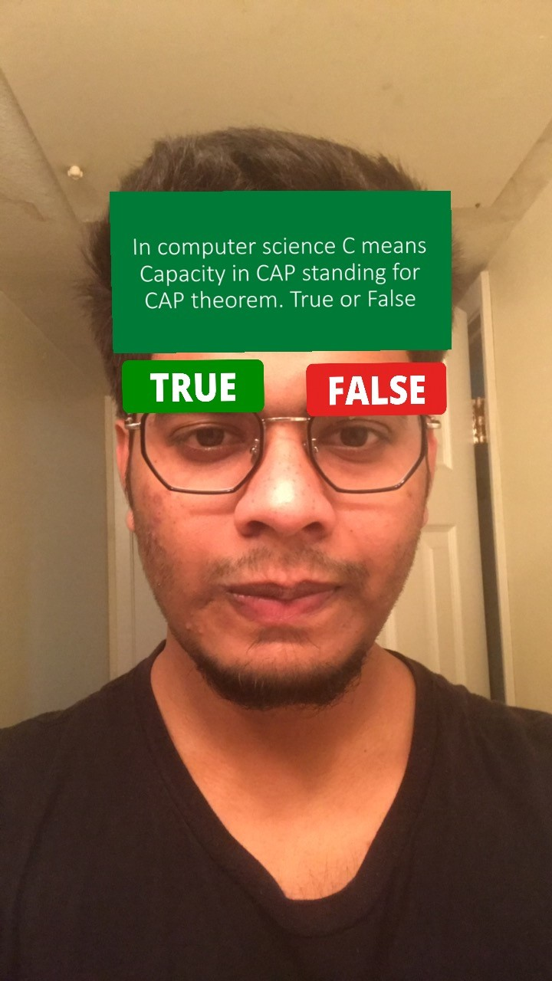
1- The quiz tool
The purpose of Q-zoom is to provide an interactive way of taking the quiz in a class by just moving the head left and right.
In fact the idea behind is how a teacher can help student being entice to the learning material with something a little been different. Thus with this quiz tool . Questions are usually true or false questions. The student has in front of the screen the question as a tag and 2 smalls tag of true or false at the side. He get the right answer when he got the motion to the right tag.

Slide 5

2-the game tool
This is a game that is controlled by a motion of the head too. There is a small bird which has to collect the star and these stars are falling from the sky.
The main purpose of this game is to arrange some sort of fun of activity in break time. The teacher can give a reward to one of the student who has the highest score.
As we pointed out from the beginning the idea behind the project Q-zoom is to help the zoom classes to be interesting.

Slide 6
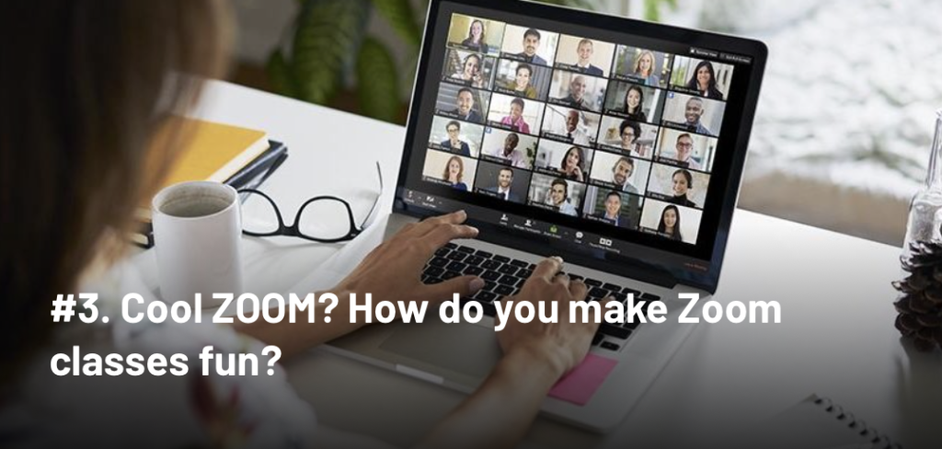
Conclusion
Q-zoom will help zoom class to be very cool.
It can be further modified to help students take MulTiple choice questions

